Slide 1
PUBLIC TRANSPORTATION AND OPTIMIZATION
PHASE-5 USING IOT

Slide 2
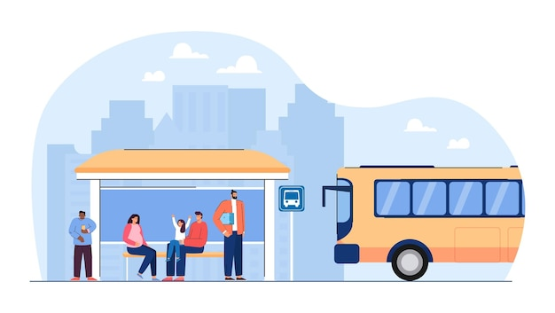

Slide 3
CONTENTS
Introduction
Description
Components required
Working
Coding
Benefits
Overview

Slide 4
INTRODUCTION
This project, we are going to implement the IOT basedpublic transportation optimization for disabled person
Drivers not waiting until passengers are seated before moving
• No one to provide assistance in getting on/off the vehicles.
• Bus stops located at inconvenient places, often with no form of shelter

Slide 5
DESCRIPTION
The aim is to make public transport a convenient and equitable mode of transportation for everyone,regradless of their physical and coagnitive abilitie.
This optimization helps promote independence and social inclusion for people with
Disabilities while fostering a more inclusive society.

Slide 6
WORKING
1St makes a public transportation outlook like a train or bus in our case we use the bus Outlook.
Project works normally we can control frd,brd,left, right direction. when the transportation vehicle reach the stoping area the door will open automatically after the passenger will scan they travel card in a RFID scanner. it will show passenger validation I’d say the door will close after all the passengers come inside the vehicle the door camera will scan the passenger who is disabled or not. So that they gave special area to the passenger an display and voice assistant will give instructions on what stop will come next.

Slide 7
COMPONENTS REQUIRED
ESP32 CAM MODULE
ESP32 DEV BOARD
SG 90 SERVO
GPS MODULE
BO MOTOR
12V 2500MAH LI-ION BATTERY
TRANSPORTATION OUTLOOK SETUP
ACCIDENT SENSOR SWITCH
REGULATOR MODULE
L298N MOTOR DRIVER

Slide 8
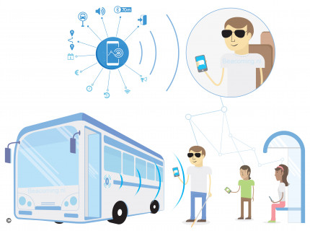

Slide 9
CODING
# Sample code for data collection and management class TransportationData: def __init__(self): # Initialize and collect data about transportation infrastructure self.routes = {...} # Information about bus routes, subway stations, etc. Self.accessibility_info = {...} # Details on accessibility features def get_accessible_routes(self, user_preferences): # Method to filter and retrieve accessible routes based on user preferences accessible_routes = [...] # Code to filter routes based on accessibility info and user preferences return accessible_routes # Sample code for route planning and optimization class RoutePlanner: def __init__(self, transportation_data): self.data = transportation_data def plan_route(self, start, destination, user_preferences): accessible_routes = self.data.get_accessible_routes(user_preferences)

Slide 10
# Implement algorithm to find optimized route from start to destination optimized_route = [...] # Algorithm to find the best route return optimized_route # Sample code for user interface (basic implementation) class UserInterface: def __init__(self, route_planner): self.route_planner = route_planner def get_user_input(self): # Code to get user input (start, destination, preferences) user_input = [...] # Collect user’s input return user_input def display_route(self, route): # Code to display the recommended route to the user # Display route on the interface # Example usage transport_data = TransportationData() planner = RoutePlanner(transport_data) interface = UserInterface(planner) user_input = interface.get_user_input() route = planner.plan_route(user_input[‘start’], user_input[‘destination’], user_input[‘preferences’]) interface.display_route(route)

Slide 11
transport_data = TransportationData() planner = RoutePlanner(transport_data) interface = UserInterface(planner) user_input = interface.get_user_input() route = planner.plan_route(user_input[‘start’], user_input[‘destination’], user_input[‘preferences’]) interface.display_route(route)

Slide 12
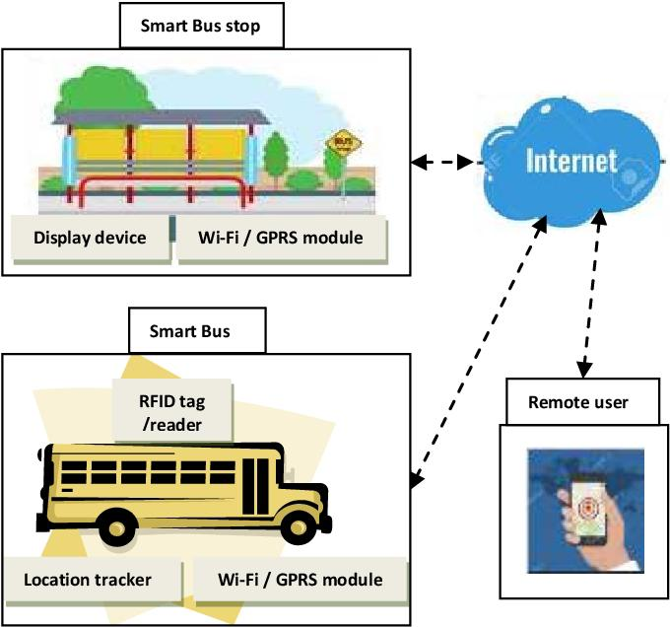

Slide 13
BENIFITS
Improves Community Health. Economic Benefits to the Community. Improves Fuel Efficiency. Public Transportation Reduces Air Pollution. Improves Road Congestion. Improves Community Mobility. Provides an Equitable Transportation System. Public Transportation Improves Commuters Productivity.

Slide 14
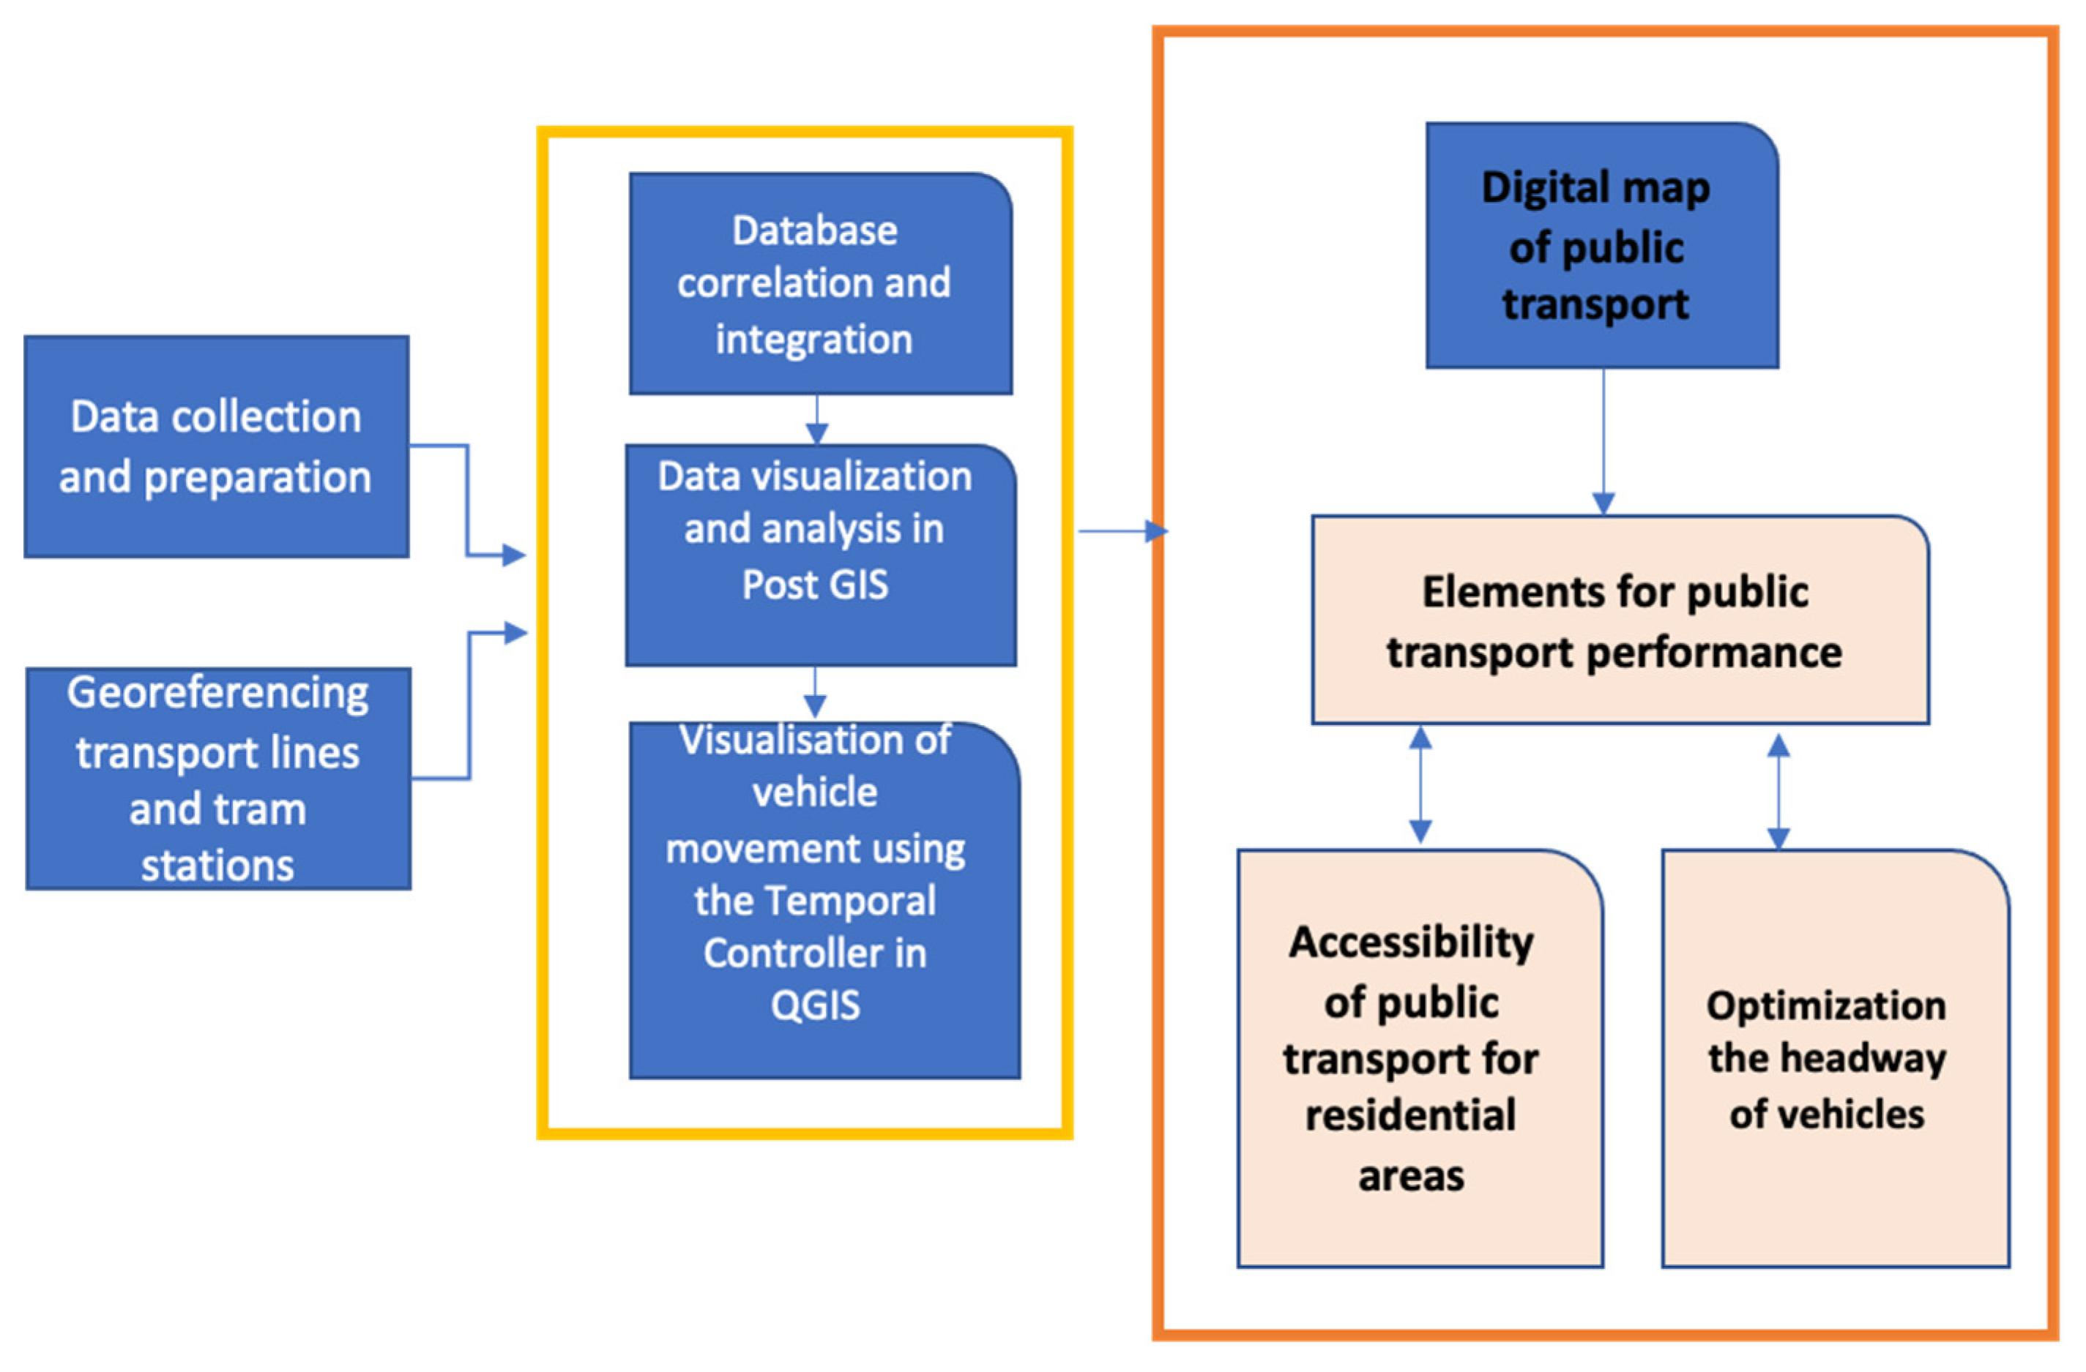

Slide 15
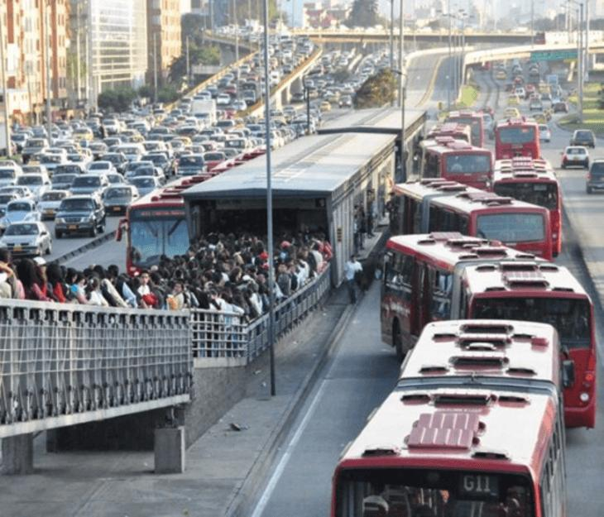

Slide 16
USING MIT APP INVENTOR
App Inventor lets you develop applications for Android phones using a web browser and either a connected phone or emulator. The App Inventor servers store your work and help you keep track of your projects.
Everything is done through a select and drop manner. This means we can select a particular chunk of code and drop in our code. Hence, no typing. Easy to test your app.

Slide 17
IBM CLOUD
IBM Cloud Paks are software products for hybrid clouds that enable you to develop apps once and deploy them anywhere.Virtual Private Cloud (VPC) is available as a public cloud service that letyou establish your own private cloud-like computing environment of shared public cloud infrastructure.

Slide 18
OVERVIEW
It allows people to travel quickly and conveniently, providing access to places that would otherwise be difficult to reach. Public transport is far more efficient and environment-friendly for cities than the means of personal transport. It can be difficult at first for people to stop using their cars, but as a result it will be better for everyone.

Slide 19


